Slide 1

Inventor 2013
What’s New in the API
Presenter Name Presenter Title

Slide 2
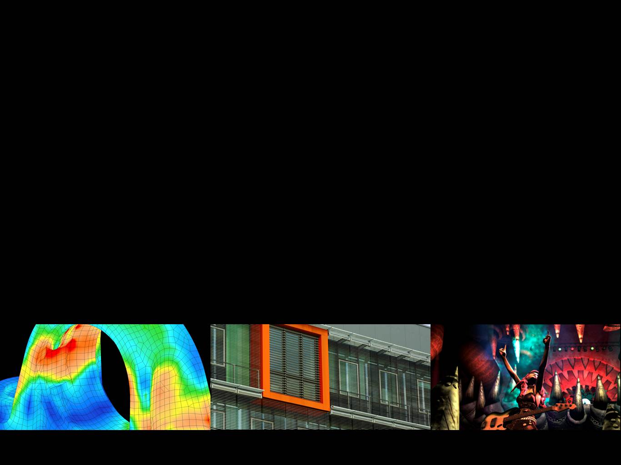
Today’s Agenda
Image courtesy of Harmonix Music Systems, Inc.

Slide 3

Bio
Describe

Slide 4
Nondisclosure Agreement
Today’s discussion is covered under your ADN Agreement with Autodesk.
The information we will be providing is highly confidential, and is to be shared within your company on “need to know basis” and to no one outside your company.
Autodesk makes no guarantees that anything presented or discussed will actually appear in the future.

Slide 5
What’s New in Inventor 2013?
43 new objects (with 390 new functions)
13 removed functions
141 new functions on existing objects
0 modified functions
…with a bit more to come.
Inventor 2011
57 new objects (with 537 new functions)
21 removed functions
635 new functions on existing objects
53 modified functions
Inventor 2012
48 new objects (with 619 new functions)
41 removed functions
303 new functions on existing objects
5 modified functions

Slide 6
Inventor API Survey Results
Areas to focus development
Full dimension style support | 42%
Frame Generator API | 35%
Other, Please Specify | 35%
Pack & Go | 24%
API for presentation documents | 22%
Support for weld symbols | 20%
Re-use of graphic widgets | 20%
Support for hatching in drawings | 12%
Nesting of work features in browser | 12%
Support for datum symbols | 8%

Slide 7
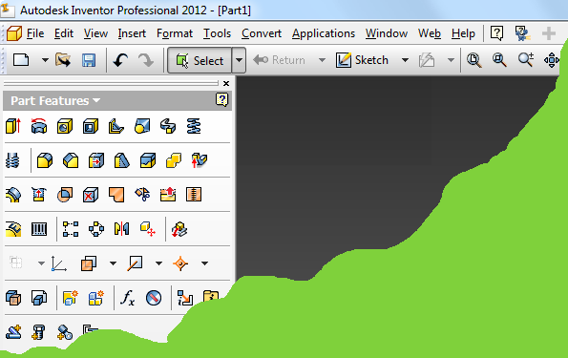
User Interface – Classic UI
Classic UI is no longer supported.
Objects removed: CommandBar, CommandBarControl, CommandBarControls, CommandBarList, CommandBars, and PanelBar
Functions removed from Environment object: ContextMenuList, DefaultMenuBar, DefaultToolBar, and PanelBar.
Functions removed from UserInterfaceEvents object: OnResetCommandBars, CommandBars, InterfaceStyle, LargeIcons, ShowPanelBar, ShowPanelTitles, ShowToolBar
You must convert all existing apps to use the ribbon.

Slide 8

User Interface – New Functionality
Support for slider control in mini toolbar.
Enhancements to the radial marking menu.
Access to all menus associated with an environment.
Can create new marking menus.
Easily clear menu, to block it from displaying.
Notes:
The mini toolbar now supports a slider control.
Various enhancements have been made to the radial marking menu.

Slide 9
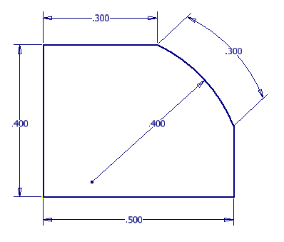
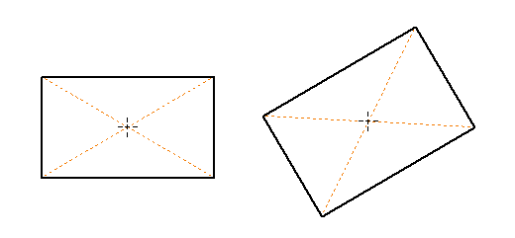
Sketch
New dimension constraint type:
DimensionConstraints.AddArcLength
New methods for creating rectangles:
AddAsThreePointCenteredRectangle
AddAsTwoPointCenteredRectangle
Geometry3d property that returns equivalent 3D geometry for a 2D sketch entity.
Supported by: SketchCircle, SketchEllipse, SketchEllipticalArc, SketchFixedSpline, SketchLine, SketchPoint, SketchSpline, SketchSplineHandle, and SketchOffsetSpline
Notes:
Inventor now supports an arc length dimension constraint. You can also created them using the API.
Inventor supports two new commands for creating rectangles by center point. These are also now supported by the API.
The new Geometry3D property is returned by all 2D sketch entities. It returns a 3D transient curve in model space that is equivalent of the 2D sketch entity.

Slide 10
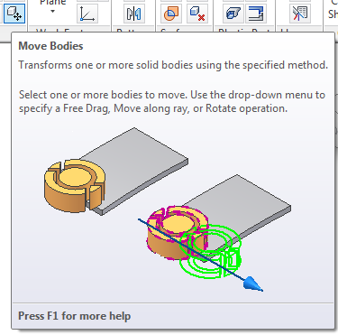
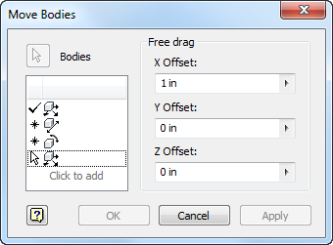
Part
Support for the creation and edit of a Move Body feature.
Client features are now supported in a flat pattern.
Notes:
API support for the creation and edit of a Move Body feature.
The creation of client features is now support for flat patterns.

Slide 11
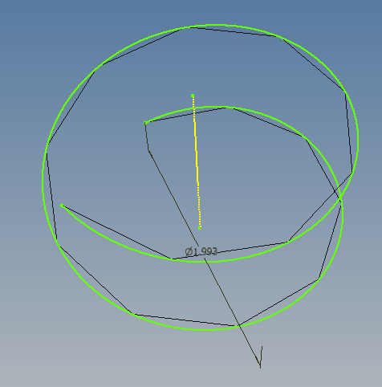
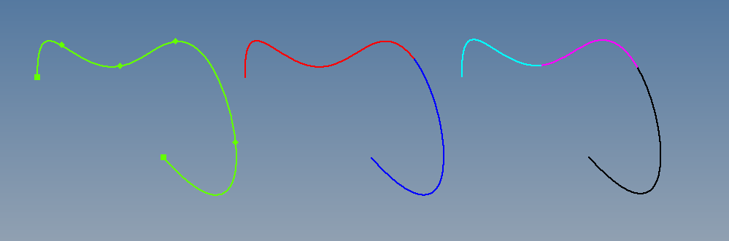
Geometry (1 of 2)
Copy method for all transient geometry objects.
Get strokes for 2d and 3d transient geometry wireframe geometry.
Extract a partial curve from 2d and 3d transient geometry splines.
Split a transient geometry spline.
Notes:
All transient geometry object now support a Copy method.
Given a 2d or 3d transient geometry curve you can now approximate with a set of points to a given tolerance.
Extract a portion of a 2d or 3d transient curve as a transient curve.
Split a 2d or 3d transient curve.

Slide 12
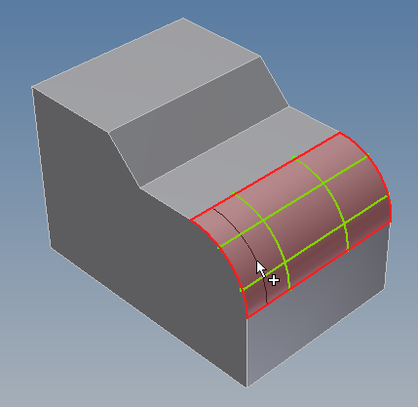
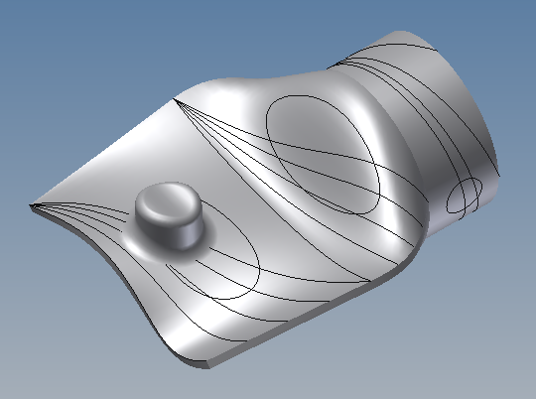
Geometry (2 of 2)
Extract an iso curve from a surface.
Get the 3d equivalent curve of a 2d parametric space curve.
Get normal of a surface at a 3d point.
Notes:
You can extract an iso-parametric curve from a surface by specifying either the u or v direction and a parameter value. A transient geometry object is returned.
2D curves can be defined in the parametric space of a surface. This method takes a 2D curve that exists in the parametric space of a surface, and returns the equivalent 3D curve as a transient geometry curve.
Given a 3D point in model space, this returns a surface normal. This can make some workflows much faster and avoids the conversion to parametric space before calculating the normal.

Slide 13

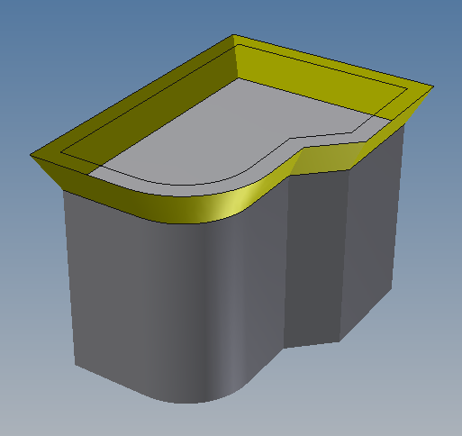
Transient B-Rep
Create a transient wire body.
Create a ruled surface.
Offset a planar wire body.
Write a transient B-Rep body as SAT or DWG.
Notes:
A wire body is the way to define wireframe geometry as B-Rep. It consists of wireframe geometry as edges and they are connected by vertices.
Using wire bodies as input, you can create a ruled surface.
A planar wire body can be offset.
A transient B-Rep can be written out as SAT or DWG.

Slide 14
Assembly
AssemblyConstraint.IsDefaultName
AssemblyOptions.EnableCrossPartSketchGeometryProjection
DerivedAssemblyDefinition.RemoveInternalVoids
Notes:
All assembly constraints now have the IsDefaultName property that indicates if the current name is the default name or if the user has renamed it.
API support for the option to have cross-part sketch geometry projection.
API support to the setting to remove internal voids when deriving an assembly.

Slide 15
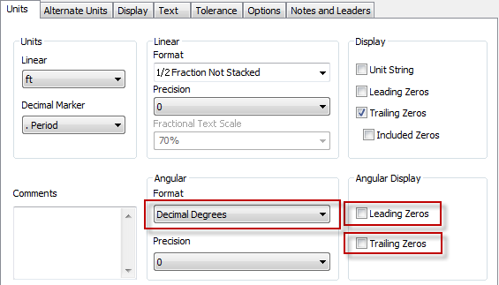
Drawing
DimensionStyle.AngularFormatIsDecimalDegrees
DimensionStyle.AngularLeadingZeroDisplay
DimensionStyle.AngularTrailingZeroDisplay
DrawingCurveSegment.Geometry
Notes:
The Style properties expose some additional dimension style functionality.
The new Geometry property of the DrawingCurveSegment object returns 2D geometry that represents the drawing curve segment. A drawing curve segment is a 3D curve.

Slide 16
Client Graphics
GraphicsDataSetsCollection.Add2 (Removed)
GraphicsNode.AllowSliceCapping
GraphicsNode.IsTransparentInPlaceEdit
GraphicsNode.OverrideOpacity
TriangleFanGraphics.BackFaceCulling
TriangleGraphics.BackFaceCulling
TriangleStripGraphics.BackFaceCulling
Notes:
The Add2 method supported creating persistent graphics data for use with a client feature. This is now supported directly on the client feature object.
AllowSliceCapping, IsTransparentInPlaceEdit, and OverrideOpacity define how client graphics will behave in various situations.
The BackFaceCulling properties define whether back face culling is performed or not on triangle graphics. If back face culling is turned on only the positive normal side of a triangle will be rendered. The mesh essentially has a front and a back and only the front will be rendered.

Slide 17
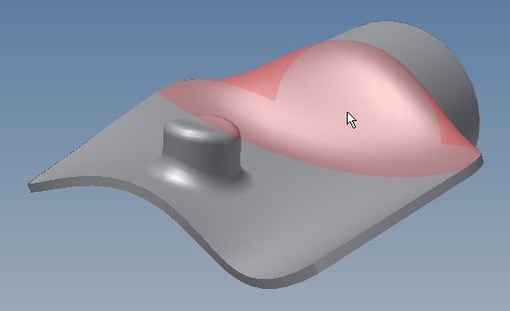
Client Graphics - Selection
GraphicsNode.DisplayName
SurfaceGraphics.ChildrenAreSelectable
SurfaceGraphics.DisplayedVertices
SurfaceGraphicsVertexList
SurfaceGraphicsVertex
SurfaceGraphicsVertex.Selectable
SurfaceGraphicsEdge.Selectable
SurfaceGraphicsFace.Selectable
Notes:
The display name of a node is used when the user is selecting and uses the “Select Other” functionality. This name is what’s displayed in the list of selectable entities.
In previous versions of Inventor, the client graphics object that was selectable was the graphics node. This was fairly heavy in some cases where many selectable objects needed to be created. This new functionality allows graphic primitives to be selected. These are the various line, triangle, and point graphics, and also the B-Rep components that make up a SurfaceGraphics instance.

Slide 18
动态仿真
新API - 动态仿真
暴露部分功能
可驱动仿真，修改荷载和获取结果

Slide 19
Consistent Materials
Inventor is now using the same set of materials as other Autodesk applications.
The API for materials and render styles is still the same as before to support existing applications, but has been re-worked internally to use the new library.
Full access to the new material functionality will come in a later release.

Slide 20
Miscellaneous
Application.CurrentLanguageFolder
ApplicationAddIns.UpdateAddInList
ColorSchemes.InterfaceStyle (Removed)
PointCloud
PointCloudPoint
PropertySets.PropertySetExists
ApprenticeServerComponent.HelpManager
DesignViewRepresentation.CopyToLevelOfDetail
DisplayOptions.AreTexturesOn
DisplaySettings.AreTexturesOn
View.AreTexturesOn
Notes:
Inventor will be supporting switching between languages without a full uninstall-reinstall. This property returns the name of the current language. For example English is “en-US”.
Used as part of the App Store support to refresh the add-in list so an add-in can be installed while Inventor is running.
InterfaceStyle has been removed. This was used to determine if Inventor was in classic or ribbon mode. It’s always in ribbon mode now.
Inventor now supported reading in a point cloud. The two point cloud objects listed here are to support the selection of points within a cloud.
Provides an easy way to determine if a property set exists without relying on a failure.
Exposes the HelpManager object through Apprentice.
Copies a level of detail.
Inventor will support turning texture display on an off as a way to increase performance. This provides API access to that functionality.

Slide 21
免注册插件 （复习）
原注册方式已经不再需要，也不推荐使用.
插件需要支持免注册
插件向导可创建免注册插件
帮助文档Documentation is provided to show how to convert existing add-ins (VB, C#, and C++) to be registry-free.
A .addin file defines the various settings that used to be defined in the registry.
Add-in dll can be placed anywhere.
The .addin file is placed in a certain directory and references the add-in dll.

Slide 22
.addin Example
<Addin Type="Standard">
<ClassId>{9c93ff52-e2fa-4ec4-8c4a-5747ad0bafef}</ClassId>
<ClientId>{9c93ff52-e2fa-4ec4-8c4a-5747ad0bafef}</ClientId>
<DisplayName>Attribute Helper</DisplayName>
<Description>Utility to help manage API attributes.</Description>
<Assembly>AttributeHelper.dll</Assembly>
<LoadOnStartUp>1</LoadOnStartUp>
<UserUnloadable>1</UserUnloadable>
<OSType>Win64</OSType>
<Hidden>0</Hidden>
<SupportedSoftwareVersionGreaterThan>15..</SupportedSoftwareVersionGreaterThan>
<DataVersion>1</DataVersion>
<UserInterfaceVersion>1</UserInterfaceVersion>
</Addin>
Notes:
The path to the add-in dll is either a full path “C:\MyStuff\AttributeHelper.dll” or it can be a relative path that is relative to the .addin file.
The OSType is a new capability this release that lets you specify if your add-in should be loaded for 32 or 64-bit OS. If not specified, it will load for both.

Slide 23
.addin Localization
<Addin Type="Standard">
<ClassId>{9c93ff52-e2fa-4ec4-8c4a-5747ad0bafef}</ClassId>
<ClientId>{9c93ff52-e2fa-4ec4-8c4a-5747ad0bafef}</ClientId>
<DisplayName Language="1033">Attribute Helper</DisplayName>
<Description Language="1033">Utility to help manage API attributes.</Description>
<DisplayName Language="1036>Attribute Helper</DisplayName>
<Description Language="1036">L'utilité pour aider gère les attributs d'API.</Description>
Notes:
The display name and description information of an add-in can now be localized.

Slide 24
.addin File Locations
Version Independent
Windows7/Vista:
%ALLUSERSPROFILE%\Autodesk\Inventor Addins\
Windows XP:
%ALLUSERSPROFILE%\Application Data\Autodesk\Inventor Addins\
Version Dependent
Windows7/Vista:
%ALLUSERSPROFILE%\Autodesk\Inventor 2013\Addins\
Windows XP:
%ALLUSERSPROFILE%\Application Data\Autodesk\Inventor 2013\Addins\
Per User Override
Windows7/Vista & XP:
%APPDATA%\Autodesk\Inventor 2013\Addins\
App Store
Windows7/Vista & XP:
%APPDATA%\Autodesk\ApplicationPlugins

Slide 25
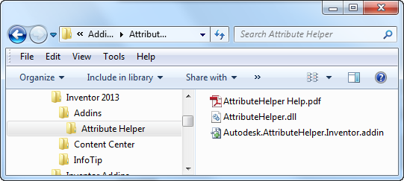
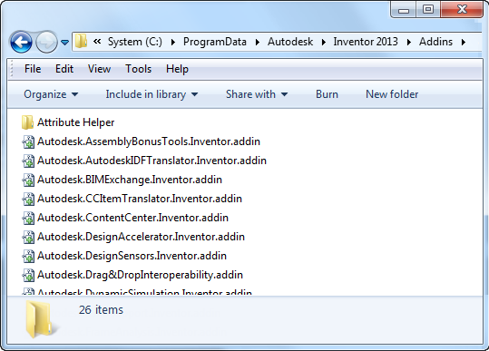
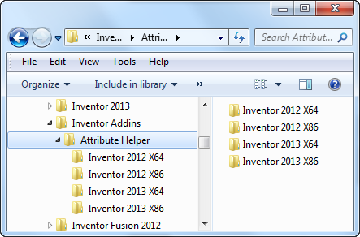
Drag and Drop Add-In Deployment
Subdirectories searched for .addin files
Path to add-in dll is a relative path, relative to .addin location.
Notes:
It’s now possible to have all of the files an add-in requires to be in a single directory and when copied into one of the valid add-in locations will enable your add-in. Subdirectories beneath the add-in location directories will be searched for .addin files. So a folder dropped into an add-in location can contain subfolders and can contain multiple .addin files that can specify to load different dll’s based on OS type and version.

Slide 26
Exchange Store for Inventor
iPhone App Store like experience
Sell your products
Free, Trial, and fee based products
Payment via PayPal
You keep 100% of the payment. (Will change in the future.)
Accessible through web
Simple install and update experience for the end-user
Store is currently English only but apps can support any language(s).

Slide 27
Inventor Apps for Exchange Store
What is an App?
Inventor add-in
Tutorial
Documentation
Library files
Standalone utility
Whatever you want it to be (Any set of files)
Web Service (not yet)
Autodesk will “repackage” your App

Slide 28
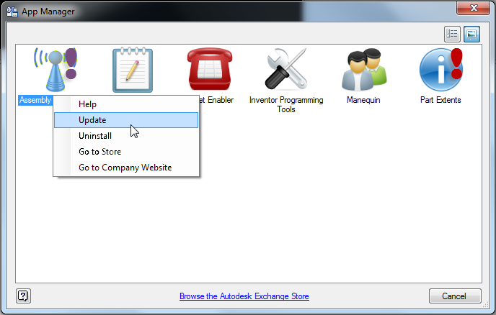
App Manager
Inventor command for the user to manage the apps they have installed on their current computer.

Slide 29
Preparing Your Add-in to be an App
Must be registry-free
Must be drag-and-drop ready.
Must have a help file that describes where to access your add-in’s functionality in Inventor and how to use it.
Must have an icon that can be used on the store and by App Manager.
Must have a description of your application that will be displayed on the store.
The ADN team will package your add-in into an installer that can be placed on the store.

Slide 30
Today’s presentations…
ADN Extranet
http://adn.autodesk.com
Under “Events”

Slide 31

Questions and Answers
Photographs by David Wakely

Slide 32
Nondisclosure Agreement
Today’s discussion is covered under your ADN Agreement with Autodesk.
The information we will be providing is highly confidential, and is to be shared within your company on “need to know basis” and to no one outside your company.
Autodesk makes no guarantees that anything presented or discussed will actually appear in the future.

Slide 33
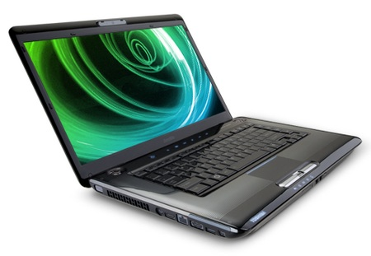
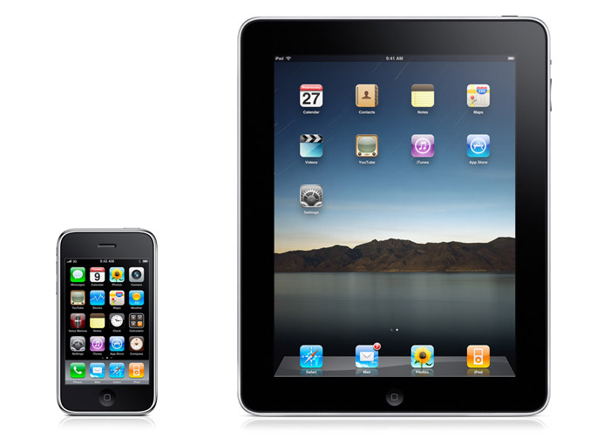

Connecting the Pieces
Notes:
The whole is greater then the parts
The parts are increasingly not viable on their own

Slide 34

Connecting the Pieces

Slide 35

Autodesk, AutoCAD, Alias, Autodesk Inventor, Inventor, Maya, Mudbox, and 3ds Max are registered trademarks or trademarks of Autodesk, Inc., and/or its subsidiaries and/or affiliates in the USA and/or other countries. Academy Award and Oscar are registered trademarks of the Academy of Motion Picture Arts and Sciences. mental ray is a registered trademark of mental images GmbH licensed for use by Autodesk, Inc. All other brand names, product names, or trademarks belong to their respective holders. Autodesk reserves the right to alter product and services offerings, and specifications and pricing at any time without notice, and is not responsible for typographical or graphical errors that may appear in this document.
© 2011 Autodesk, Inc. All rights reserved.

